Slide 1





Dr. Elizabeth R. Osborn • Larry Dorenkamp • Kala Morrow • Jennifer Jolley
For more information, contact Dr. Elizabeth R. Osborn at eosborn@iu.edu

Slide 2
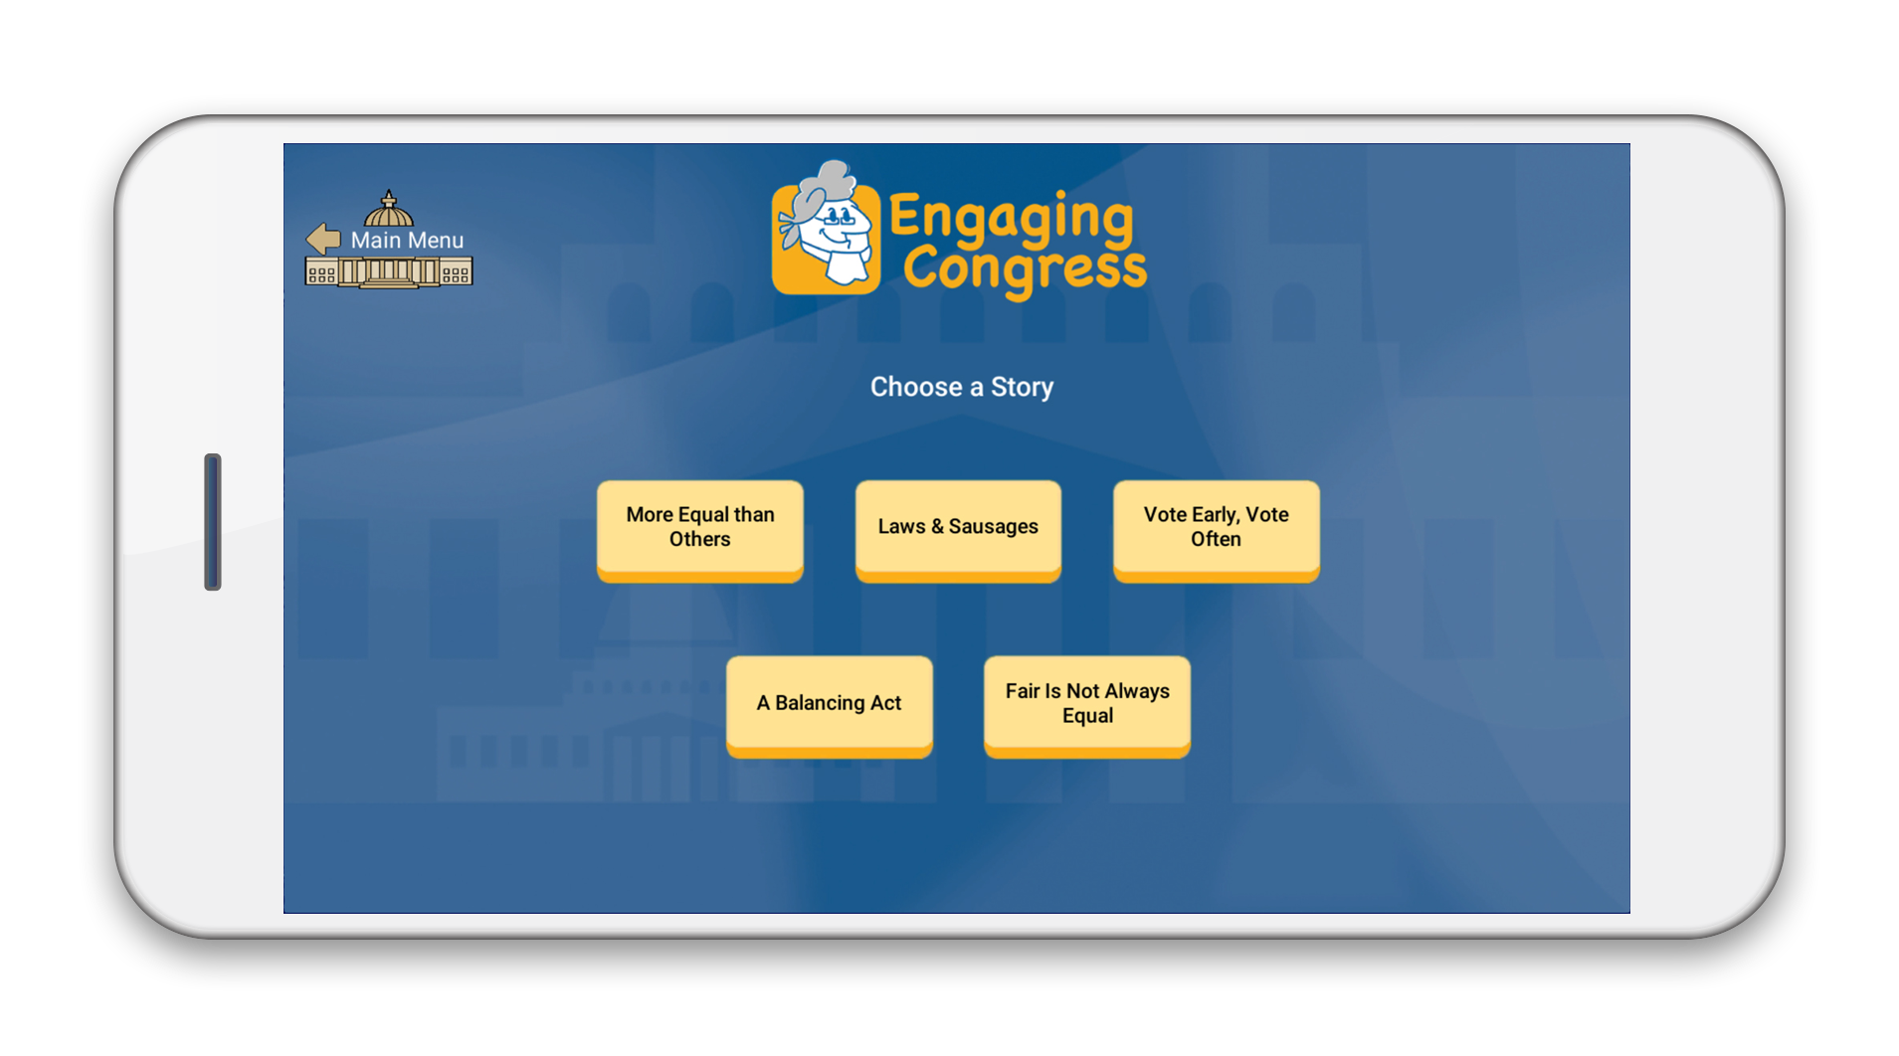

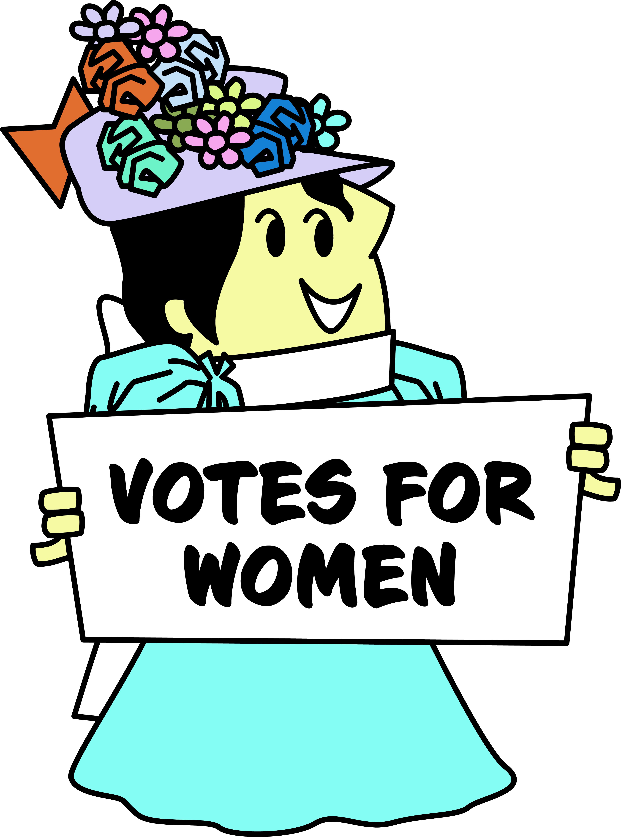
A FREE, fun, interactive civics game using primary sources to explore how government works.
FORMATTED for Chromebooks, computers, tablets and mobile devices
TARGETED for grades 6 through 12
DESIGNED with Library of Congress sources using inquiry-based analysis

Slide 3
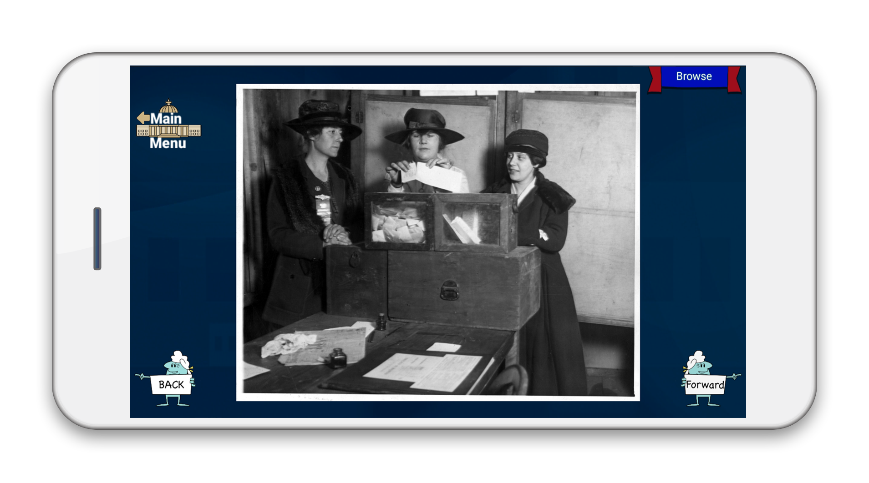
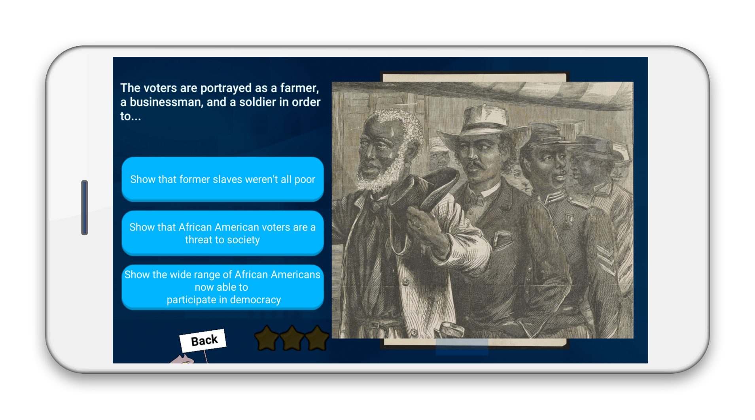
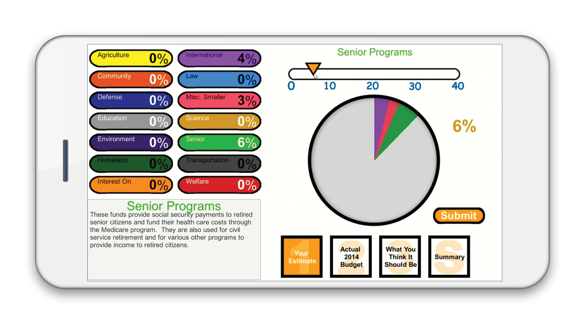



Uses inquiry-based analysis with:
Library of Congress Primary Sources
Interactive Skill Builders
Brief Videos
Content Assessed with:
Trivia Challenges
Knowledge Check
Mini Games
Primary Source Gallery
Documents for further in-class analysis.
Provides teachers with additional Library of Congress Teaching with Primary Sources (TPS) resources to extend content.
Available for free at

Slide 4


Slide 5
A Quick Glance at Issues of the Progressive Era
KALA MORROW
Instructional Specialist, Tyler ISD
Texas

Slide 6
Progressive Era
Chicago Sausage Factory (photo)
16th Amendment
“New Man on the Job” (16th Amendment political cartoon)
“A Visit to the Big Store” (corruption of power political cartoon)
Suffragists at the ballot box (photo)
Engaging Congress
allows you to search by Era!
Notes:
One way that we have been able to utilize Engaging Congress resources in Tyler ISD, in addition to initial instruction and enrichment, is as an intervention tool. If we have students that need to focus on a standard, skill, or an era because they don’t master that content on a short cycle assessment or a benchmark, we can use EC to cater specifically to what that student may need. We’ve aligned EC resources to our state standards and have vetted them for meeting the demands of our specificity.
TEKS - Texas Essential Knowledge & Skills

Slide 7
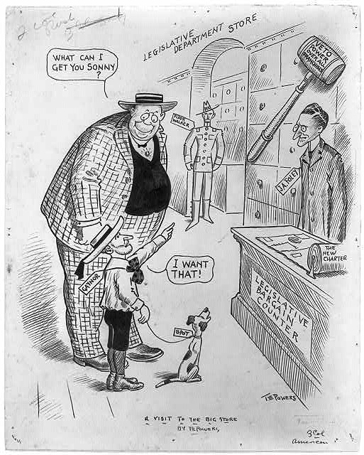
(3) History. The student understands the political, economic, and social changes in the United States from 1877 to 1898. The student is expected to:
(A) analyze political issues such as Indian policies, the growth of political machines, and civil service reform;
(B) analyze economic issues such as industrialization, the growth of railroads, the growth of labor unions, farm issues, the cattle industry boom, the growth of entrepreneurship, and the pros and cons of big business;
Compelling Question: How do we ensure that money does not influence public policy?
Notes:
We use QFT for kids to focus on inquiry which fosters agency, identity, and ownership! We have students take a look at a political cartoon and immediately start posing questions! In a digital format, you can create a Padlet and allow students to post their questions there! Promotes a safety net for your students and can increase engagement! Matches TEKS 3A, 3B

Slide 8
(5) History. The student understands the effects of reform and third-party movements in the early 20th century. The student is expected to:
(A) analyze the impact of Progressive Era reforms, including initiative, referendum, recall, and the passage of the 16th, 17th, 18th, and 19th amendments;
(28) Social studies skills. The student understands how historians use historiography to interpret the past and applies critical-thinking skills to organize and use information acquired from a variety of valid sources, including technology. The student is expected to:
(A) analyze primary and secondary sources such as maps, graphs, speeches, political cartoons, and artifacts to acquire information to answer historical questions;
(C) apply the process of historical inquiry to research, interpret, and use multiple types of sources of evidence;
(D) evaluate the validity of a source based on corroboration with other sources and information about the author, including points of view, frames of reference, and historical context; and
(E) identify bias and support with historical evidence a point of view on a social studies issue or event
TEKS
Notes:
CC Historical Thinking standards match our Social Studies skills (processing skills) - these are our declarative and procedural statements - I know and I can show!

Slide 9
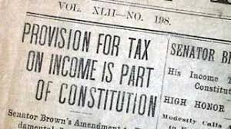
Explore the 16th Amendment Resources:
Remember to pose questions that may support you in responding to the compelling questions:
How do we equitably collect the revenues needed to run our government?
How do we most fairly distribute the great wealth of our nation?

Slide 10
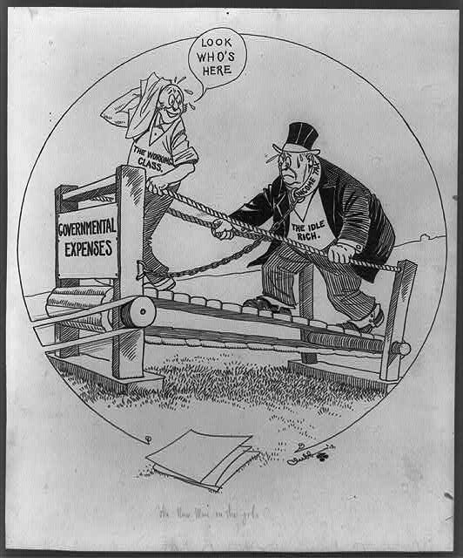
Overview
Point of View
Texts
Inference
Conclusion
Notes:
OPTIC is a strategy we encourage for analyzing primary sources - specifically cartoons! You can have your students do this before going in to EC, or as the checkpoint after EC.
Or TACOS?

Slide 11
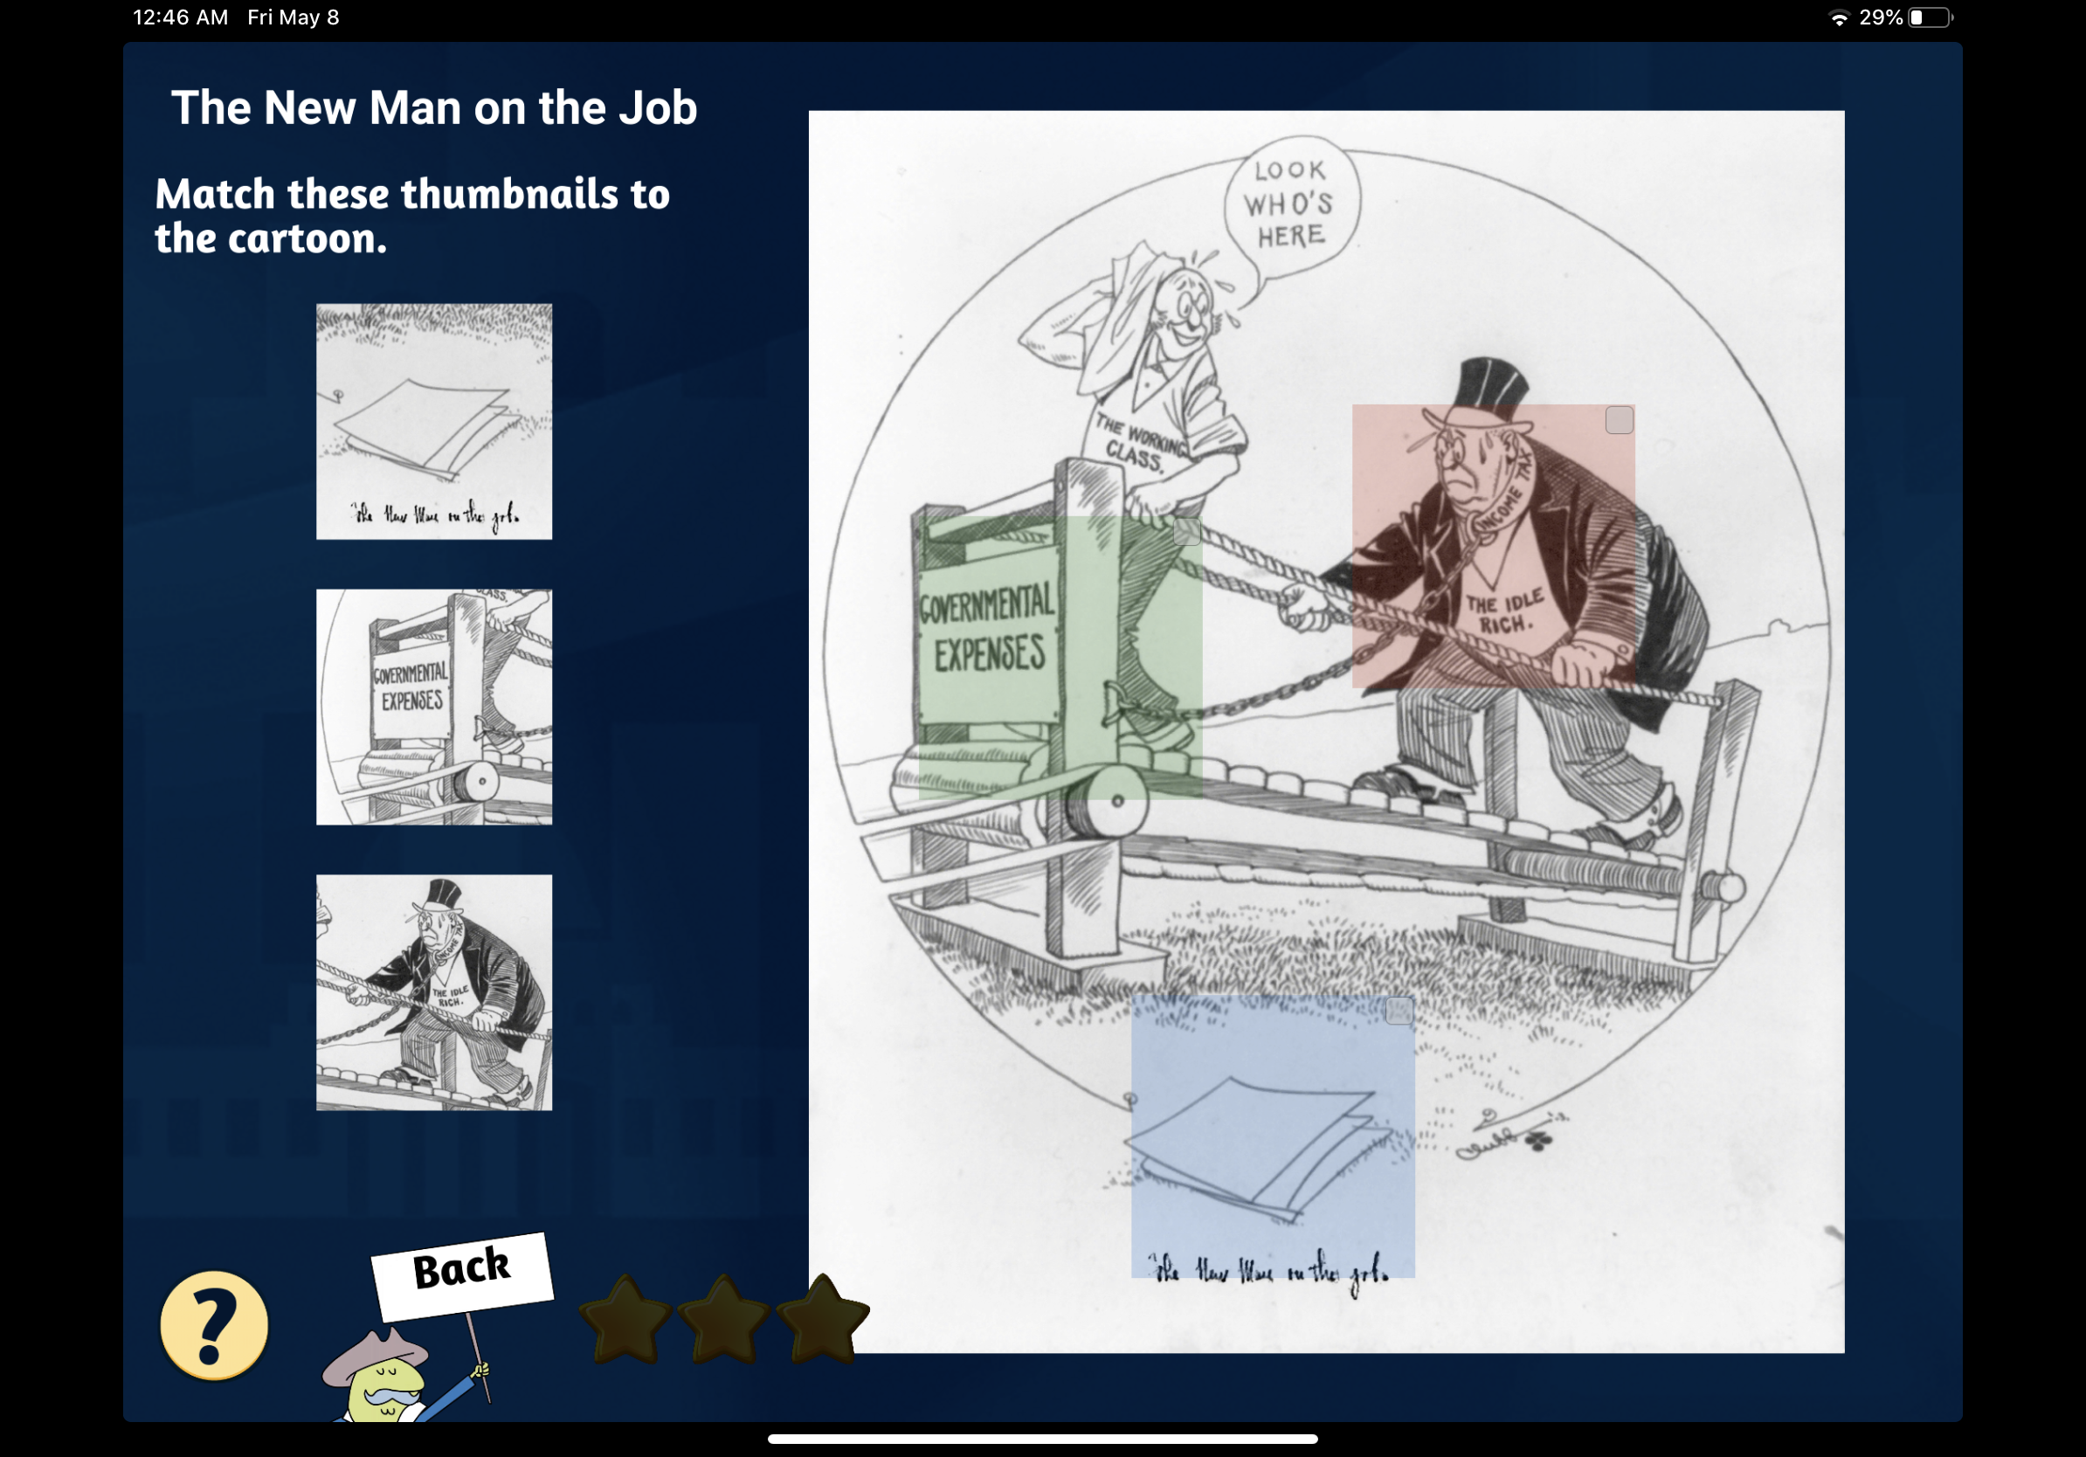
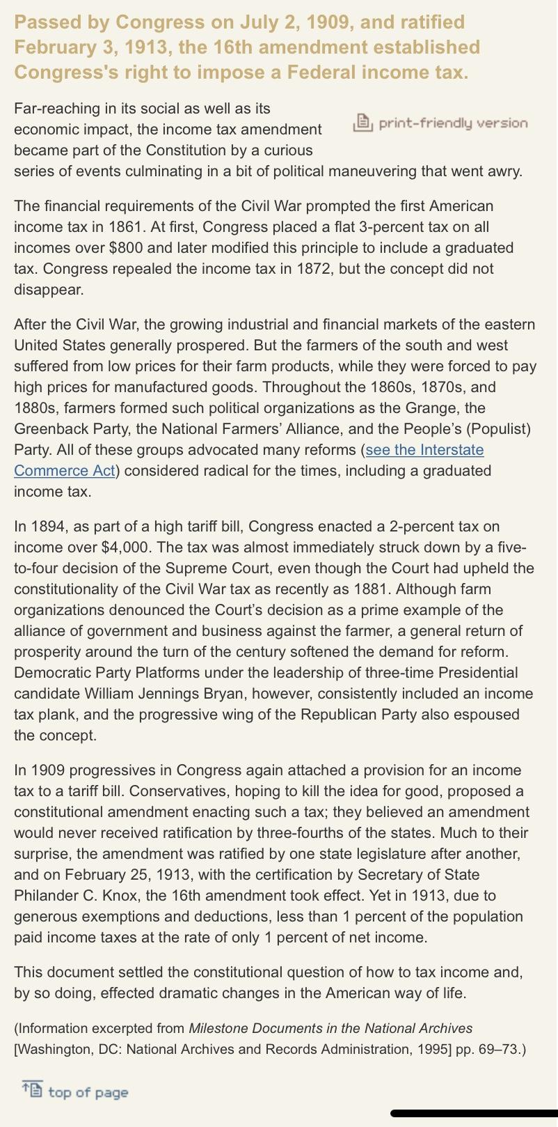
Instructions to Students:
Before moving on to the Knowledge Check, you MUST read the 16th Amendment!
Notes:
Works as a great tool for students to experience success! Built in modifications - fewer answer choices - easier questions -
They get the big picture going in to the reading! Text heavy - built in support for struggling readers - they already know the BIG IDEA!
Important element of scaffolding -

Slide 12
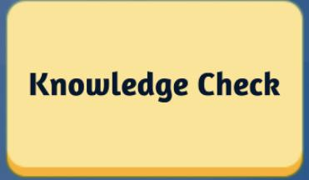
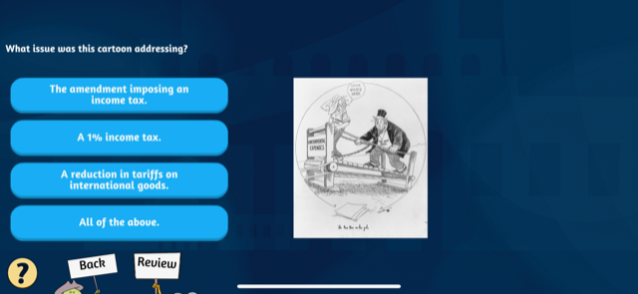
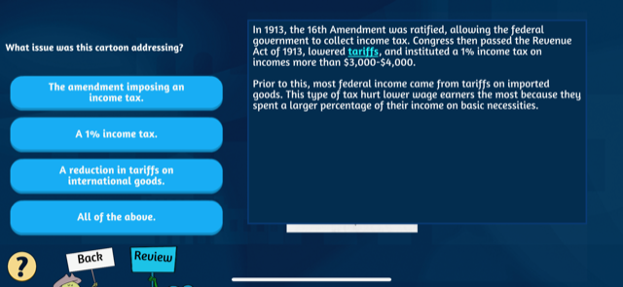
Notes:
The built in review if students miss a question is great for self monitoring.
Tyler ISD aligns its district expectations for instruction with the 5 Dimensions of TRU - the lesson presented highlights - Content, Cognitive Demand, Equitable Access to Content, Agency, Ownership & Identity & Formative Assessment,

Slide 13

Available for free at

Slide 14
JENNIFER JOLLEY
Palm Bay Magnet High School
Melbourne, Florida
Twitter: @jjolleymsd

Slide 15
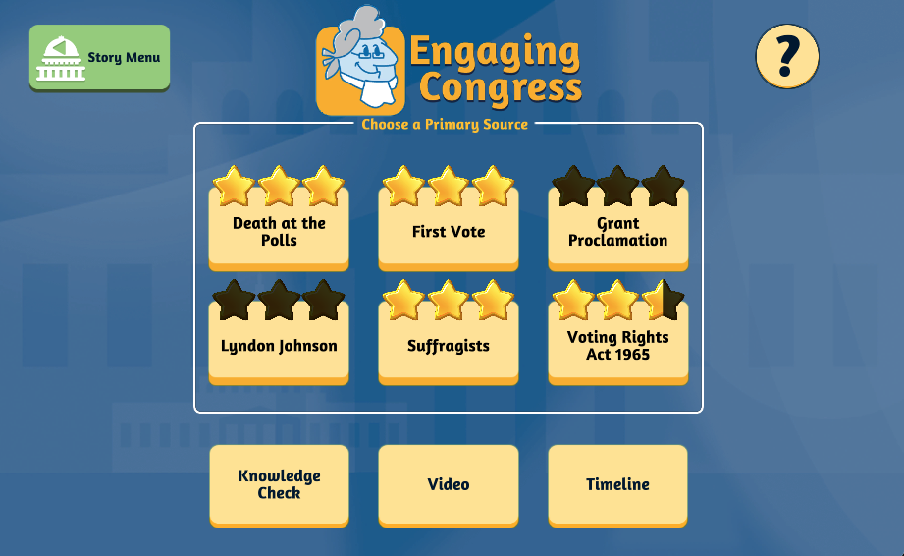
VOTE EARLY, VOTE OFTEN

Slide 16
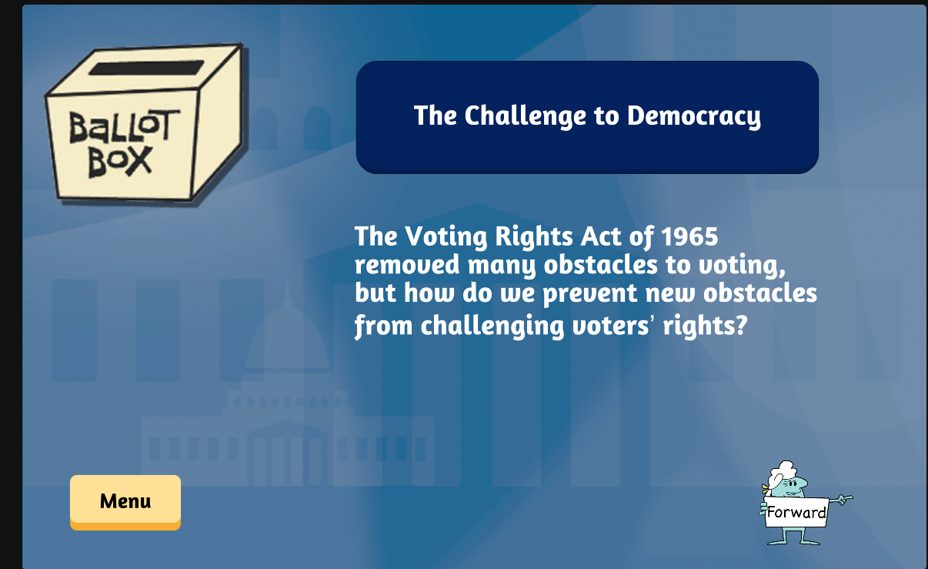

Slide 17
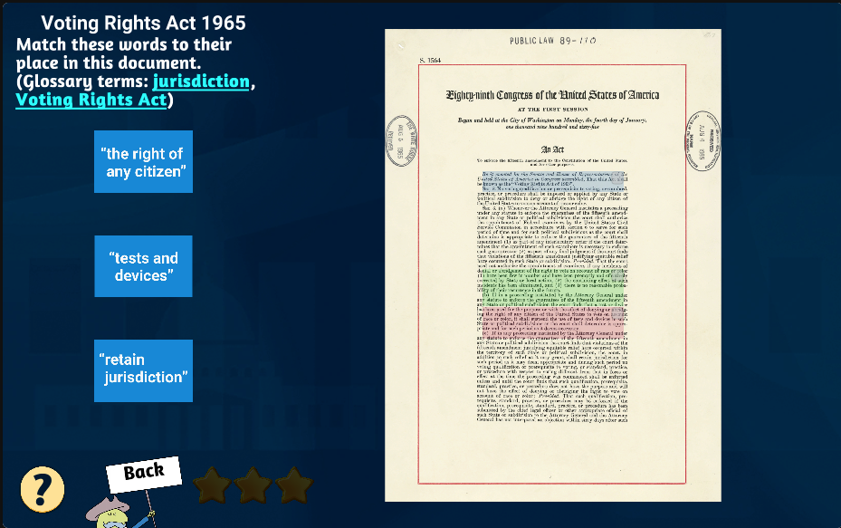

Slide 18
Dive Deeper? More Rigor?
Voting Rights Act of 1965 (August 6, 1965)
55th anniversary this year!
TPS Teachers Network
https://tpsteachersnetwork.org/album/26099-voting-rights-act-of-1965

Slide 19
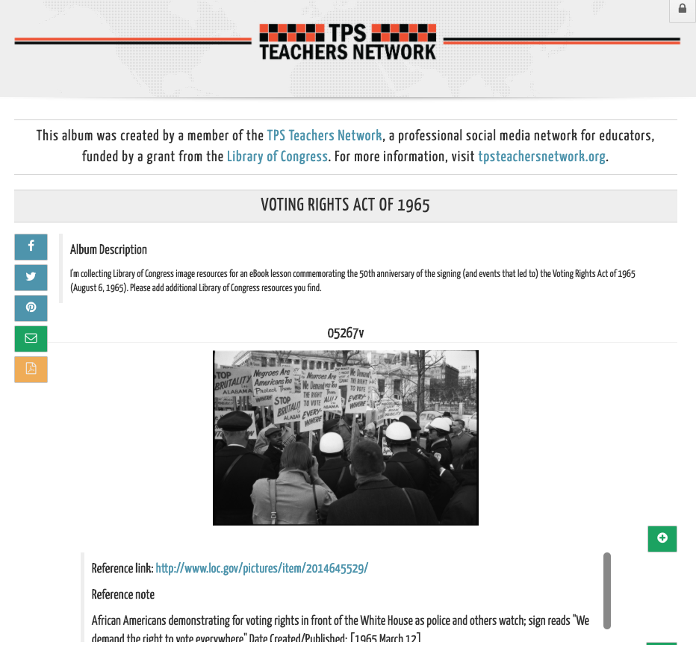
TPS Teachers Network
https://tpsteachersnetwork.org/album/26099-voting-rights-act-of-1965

Slide 20
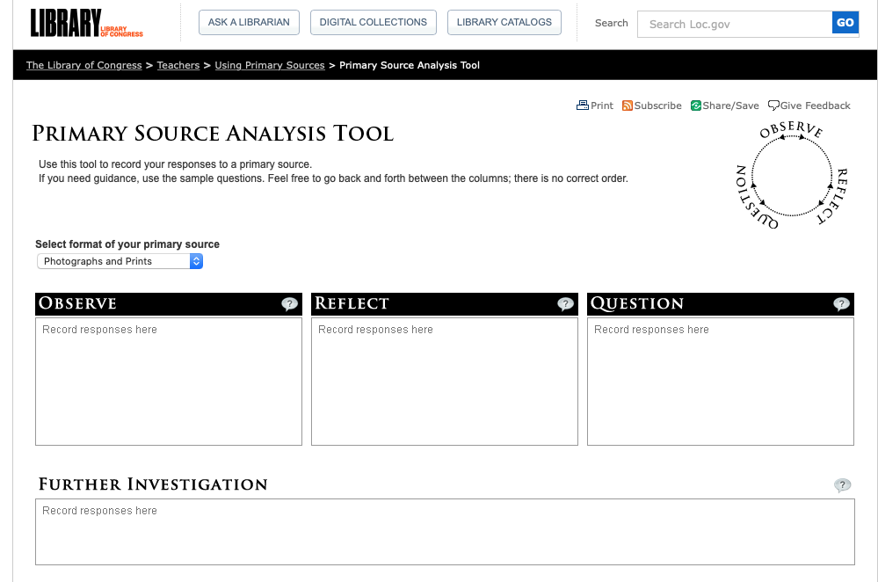
http://www.loc.gov/teachers/primary-source-analysis-tool/

Slide 21
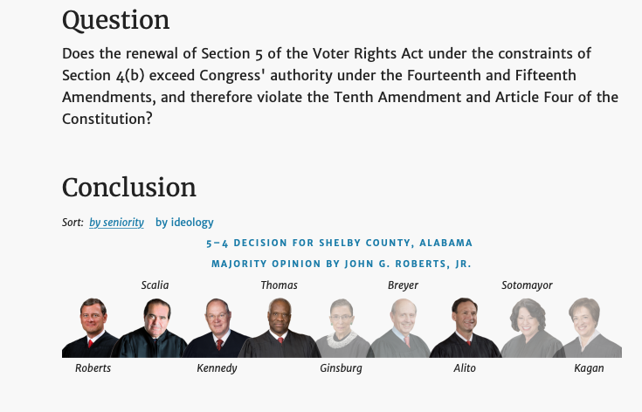
Shelby County v. Holder (2013)
Shelby County v. Holder (2013) https://www.oyez.org/cases/2012/12-96/

Slide 22

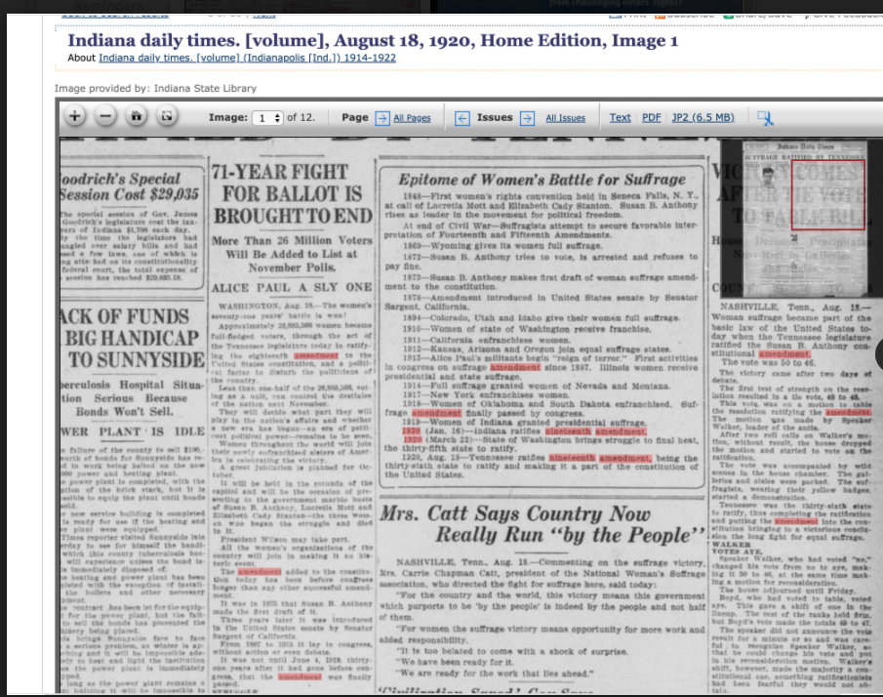
Indiana daily times. [volume] (Indianapolis [Ind.]), 18 Aug. 1920. Chronicling America: Historic American Newspapers. Lib. of Congress.
https://chroniclingamerica.loc.gov/lccn/sn85047611/1920-08-18/ed-1/seq-1/

Slide 23
Women’s Suffrage Resources
Shall Not Be Denied Women Fight for the Vote (LOC Exhibit) https://www.loc.gov/exhibitions/women-fight-for-the-vote/about-this-exhibition/ Elizabeth Cady Stanton Papers https://www.loc.gov/collections/elizabeth-cady-stanton-papers/about-this-collection/ Women's Suffrage http://www.loc.gov/teachers/classroommaterials/primarysourcesets/womens-suffrage/
Votes for Women: The Struggle for Women's Suffrage Selected Images From the Collections of the Library of Congress http://www.loc.gov/rr/print/list/076_vfw.html
FILM, VIDEO: Selma, the Voting Rights Act & Reel History https://www.loc.gov/exhibitions/women-fight-for-the-vote/about-this-exhibition/
19th Amendment Primary Source Document https://www.ourdocuments.gov/doc.php?flash=false&doc=100&page=transcript Rightfully Hers: American Women and the Vote https://museum.archives.gov/rightfully-hers

Slide 24
LARRY DORENKAMP
North Hills Middle School
Pennsylvania

Slide 25
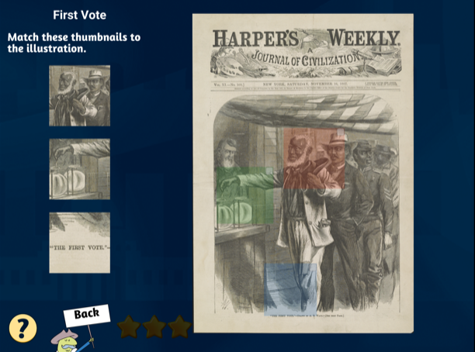

Slide 26
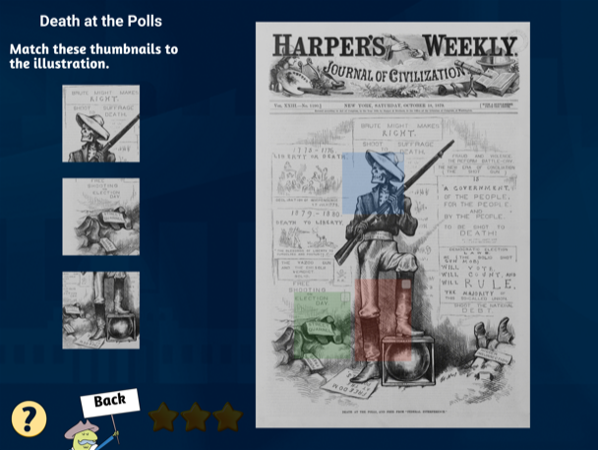

Slide 27
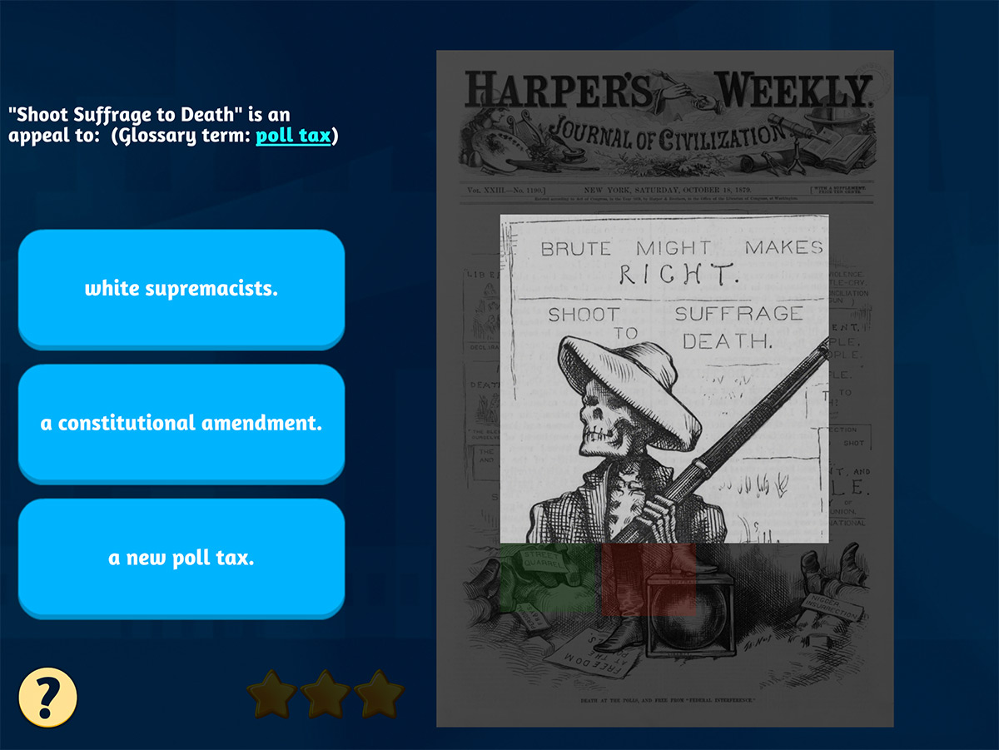

Slide 28
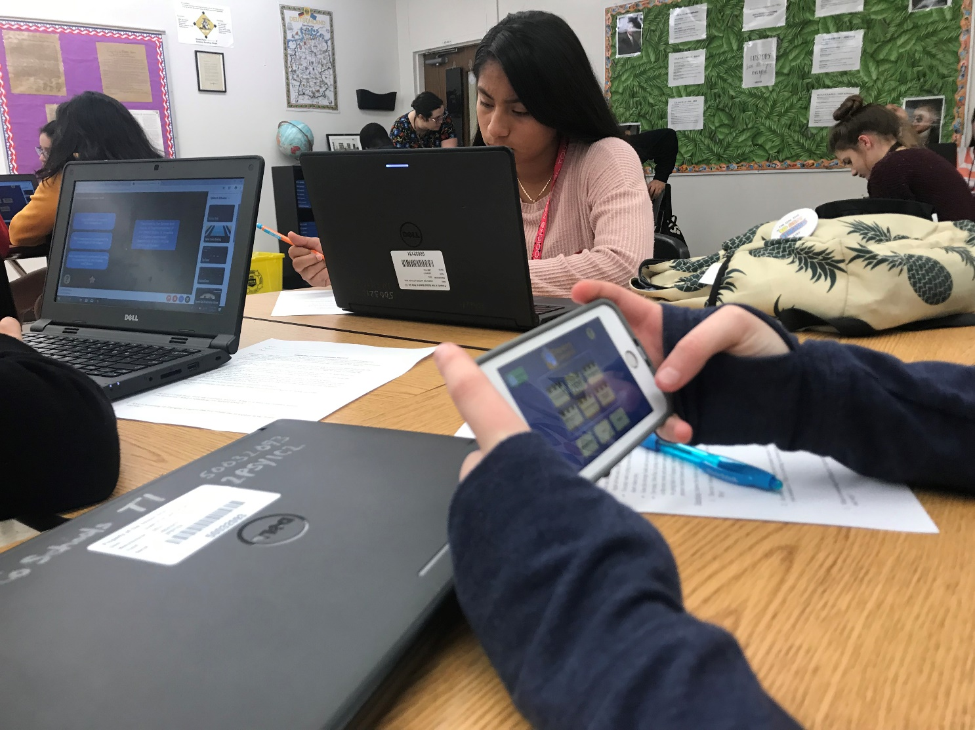
Accessible on Multiple Platforms
Students can download onto smart phone or iPads. After initial download
No internet is needed once downloaded
No data is needed
Also available through the Web
Laptops
Desktops
Chromebooks
Teachers can lead sessions through Zoom or other virtual classroom technology

Slide 29
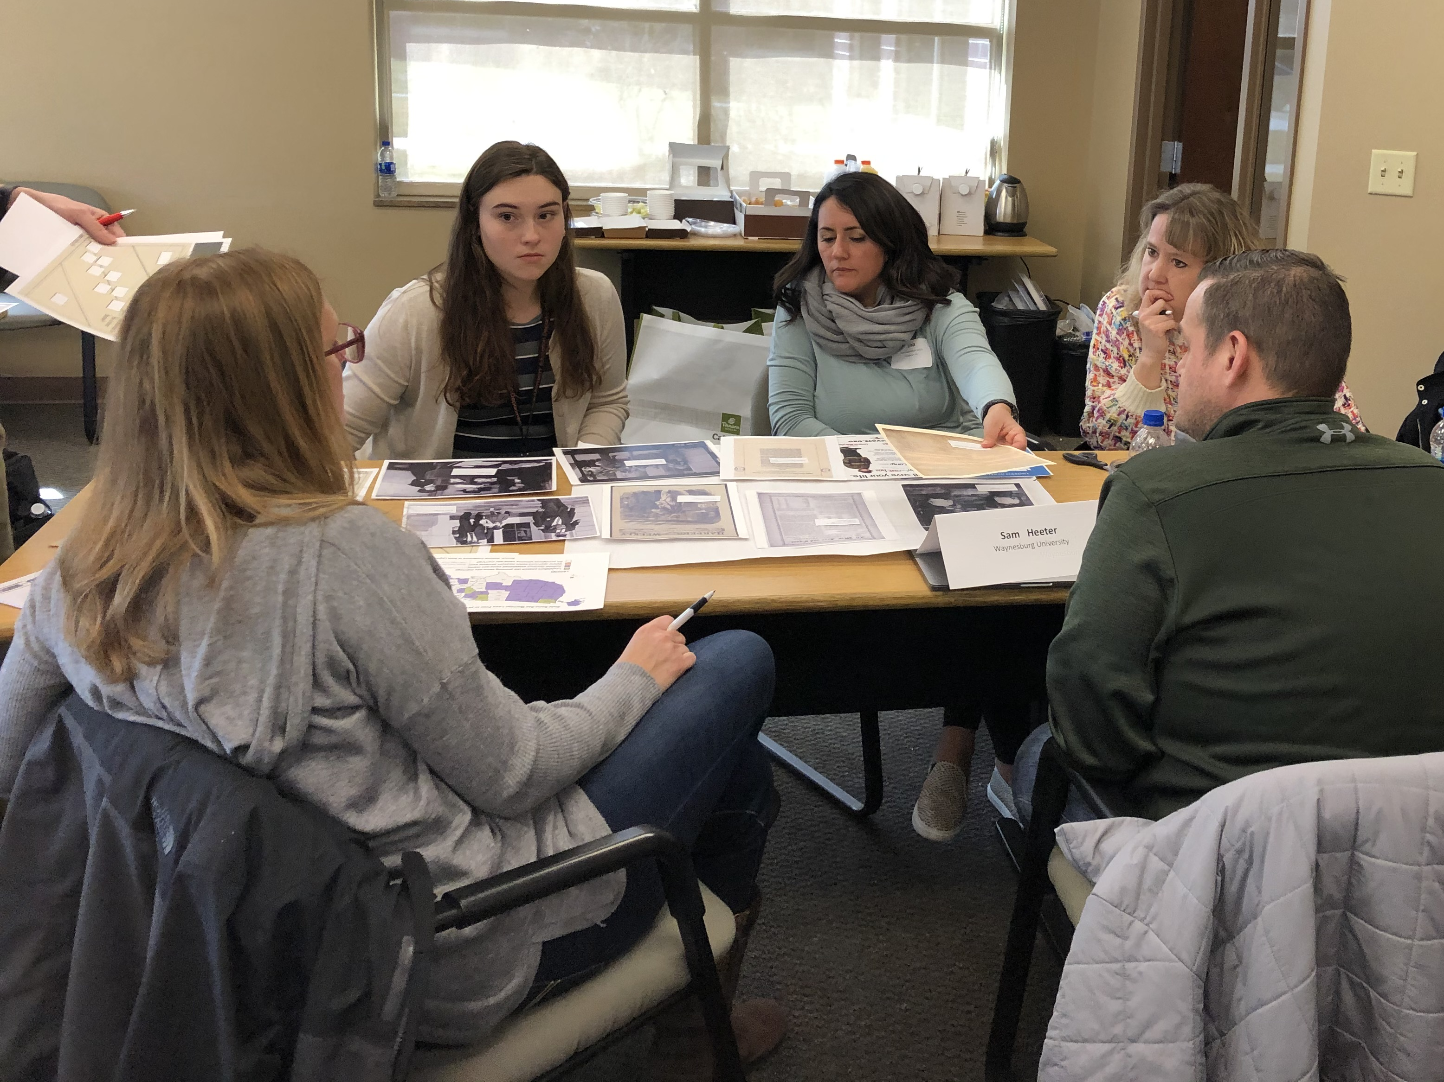
Adaptable for Learners at All Grade/Ability Level
Each unit has a variety of primary sources that can be modified or extended for any ability level or grade
Maps
Text
Photographs
Political cartoons
Charts
Videos are closed-captioned
Keywords are hyperlinked to a glossary
Need help correlating to your state standards? Let us know and we can help!

Slide 30
Dr. Elizabeth R. Osborn • Larry Dorenkamp • Kala Morrow • Jennifer Jolley
For more information, contact Dr. Elizabeth R. Osborn at eosborn@iu.edu

